Slide 1
Smart Recommendation System for agriculture
Submitted To : Dr. Priyanka Bagade

Slide 2
Recap :
Problem Statement :
To deliver real time and continuous interval-based monitoring and analysis of soil test report to enhance crop yield
Proposed methodology :
Measure using WSN
Store using Raspberry pi or Cloud based
Analyze using Machine learning
Recommend Required fertilizer/Crop

Slide 3





Wireless Sensor Network
We have partially simulated WSN

Slide 4
Analysis
Sensors will be placed in different locations in field connected with Wi-Fi
A bulk amount of data will be received to the raspberry-pi
Federated Learning: filter out data received from the nodes(using TNN)
Decision Tree : after receiving filtered data trained model will predict the crop that Is best suitable for that soil or fertilizer that needed to grow better yield of crop

Slide 5
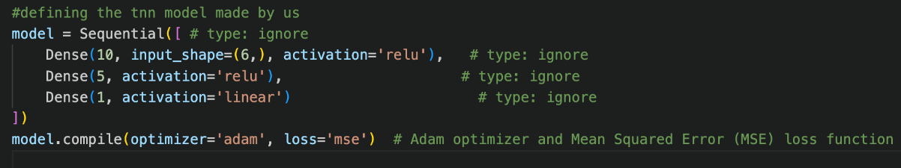
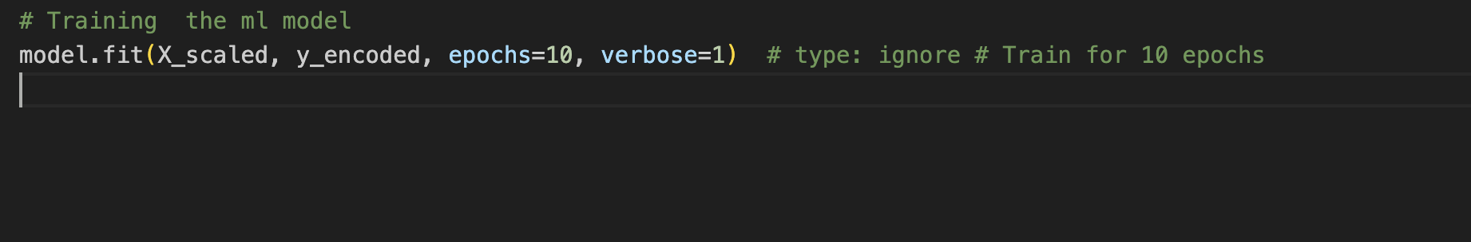
Tiny Neural Network
Defining and Training TNN
Benefits
Tiny Neural Network (TNN) is a streamlined neural network model tailored for low-resource environments, such as those used in TinyML applications.
Why we have used :
Low Computational Load: Uses fewer neurons and layers.
Small Memory Footprint: Reduces model size, allowing it to fit into limited memory.
Efficient Power Consumption: Designed for battery-operated devices with low power requirements.
Latency Optimization: Real-time processing with minimal delay.
The input layer has 6 units, corresponding to the 6 input features.
The hidden layer has 5 units, using ReLU as the activation function.
The output layer has a single unit for predicting the fertilizer type.
This trains the model using the standardized features (X_scaled) and the encoded target values (y_encoded).

Slide 6
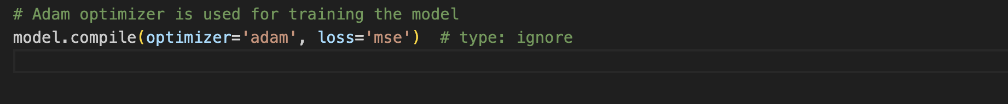
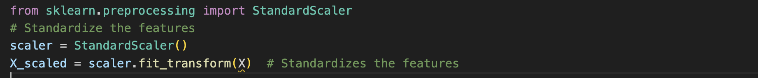
Model Optimization and Deployment
1. Optimizer: Adam Optimizer Description:
Adam is a highly efficient optimization algorithm that combines the advantages of Momentum and RMSprop. It adapts the learning rate for each parameter based on the gradient's first and second moments.
2. Standardization of Features Description:
StandardScaler is applied to standardize the features, ensuring they have zero mean and unit variance. This helps neural networks converge faster and improves the stability of the optimization process.

Slide 7
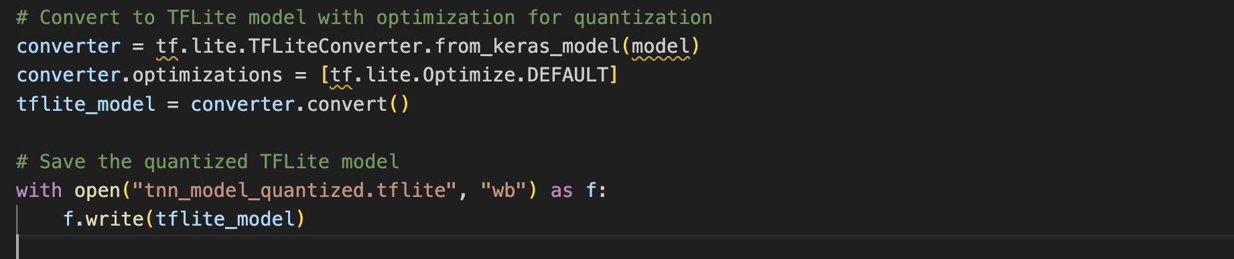
Model Optimization and Deployment
1. Model Quantization for TFLite Description:
Model quantization reduces the precision of the model weights and activations, making the model smaller and faster for mobile and embedded devices.
2. Training for Multiple Epochs Description:
Training the model for multiple epochs (in this case, 10 epochs) allows the model to learn from the data and converge to an optimal solution.

Slide 8
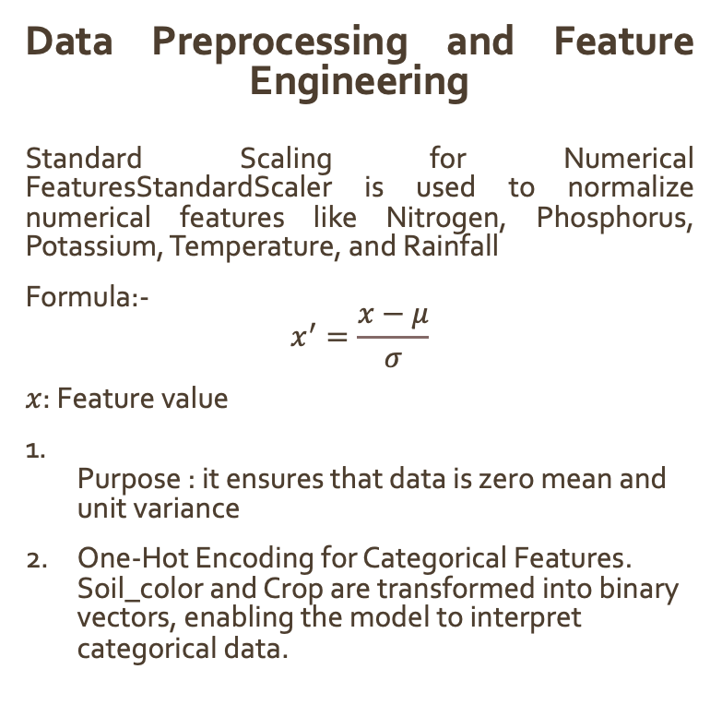
Mathematical Formulation
Data Preprocessing and Feature Engineering Standard Scaling for Numerical FeaturesStandardScaler is used to normalize numerical features like Nitrogen, Phosphorus, Potassium, Temperature, and Rainfall
Formula:- $$x^{′}=\frac{x−μ}{σ}$$
$x$: Feature value
Purpose : it ensures that data is zero mean and unit variance
One-Hot Encoding for Categorical Features. Soil_color and Crop are transformed into binary vectors, enabling the model to interpret categorical data.
Dense Layer Processing:
The TNN model consists of a simple architecture with dense layers. The formula for the output of a dense layer is:
output=f(W⋅X+b)
Where:
X is the input data
W are the weights
b is the bias term
f is the activation function (ReLU or Sigmoid)

Slide 9
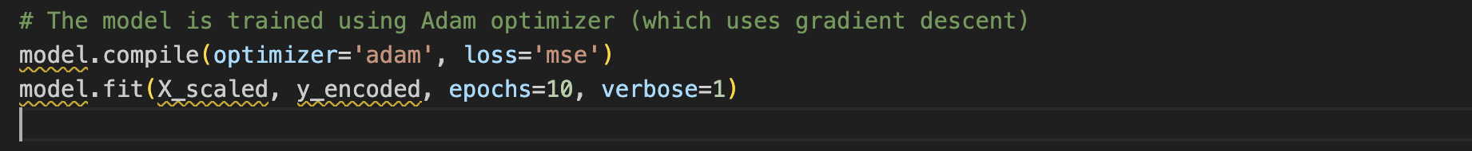
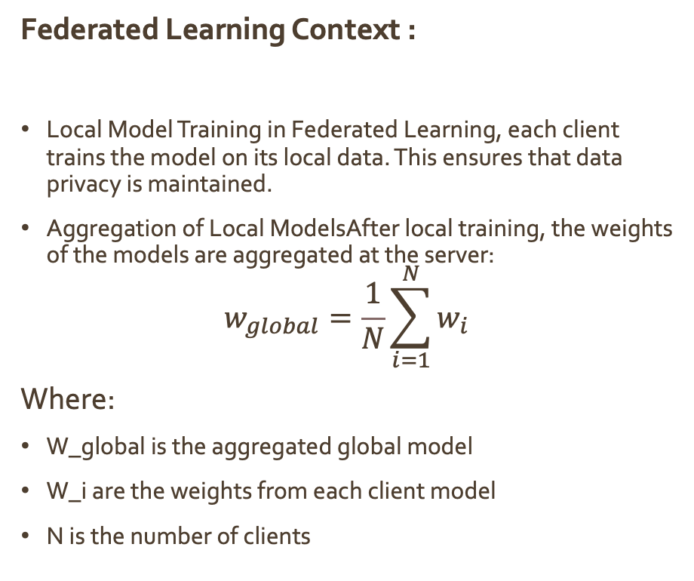
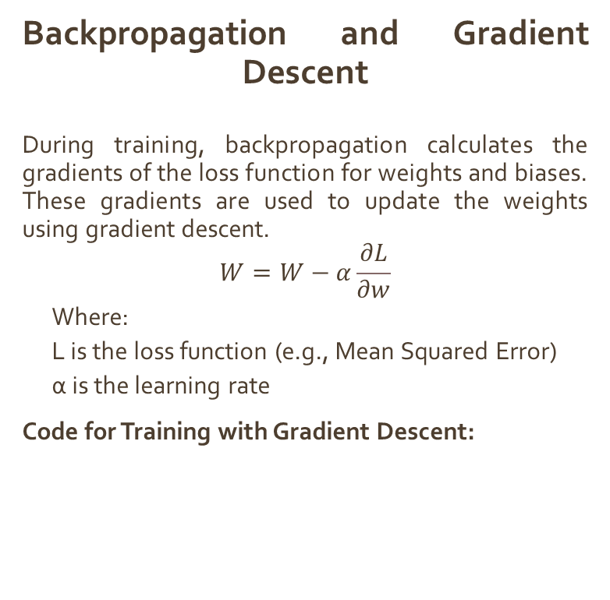
Mathematical Formulation
Backpropagation and Gradient Descent During training, backpropagation calculates the gradients of the loss function for weights and biases. These gradients are used to update the weights using gradient descent.
$$W=W−α\frac{∂L}{∂w}$$
Where:
L is the loss function (e.g., Mean Squared Error)
α is the learning rate
Code for Training with Gradient Descent:
Federated Learning Context :
Local Model Training in Federated Learning, each client trains the model on its local data. This ensures that data privacy is maintained.
Aggregation of Local ModelsAfter local training, the weights of the models are aggregated at the server:
$$w_{global}=\frac{1}{N}\sum_{i=1}^{N}{w_{i}}$$
Where:
W_global is the aggregated global model
W_i are the weights from each client model
N is the number of clients

Slide 10
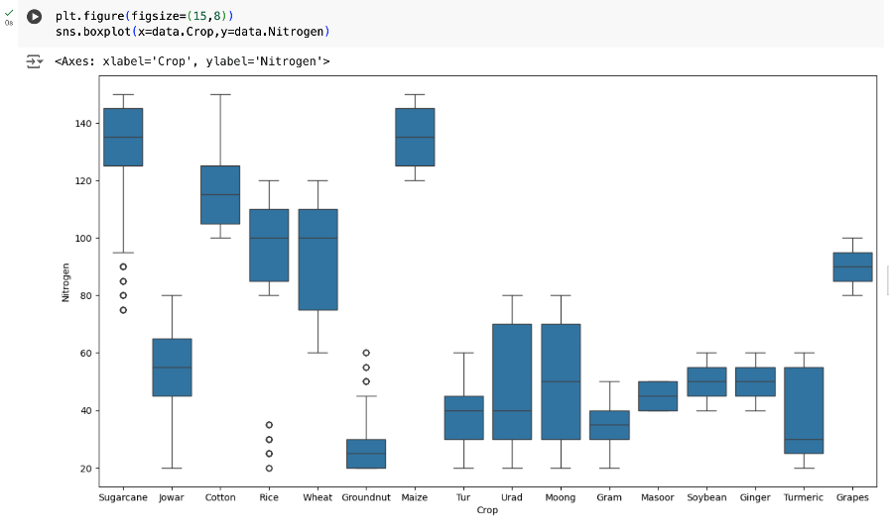
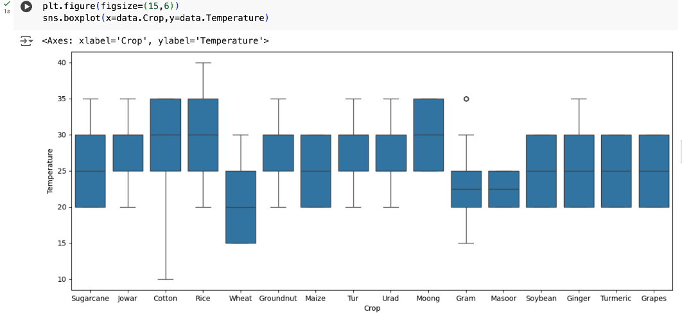
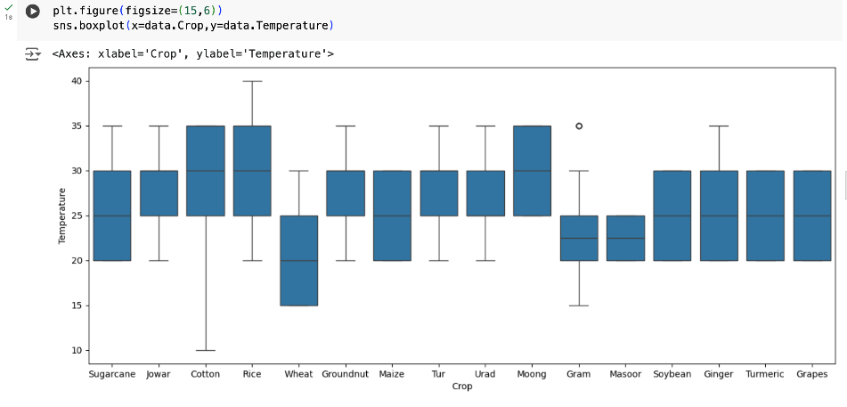
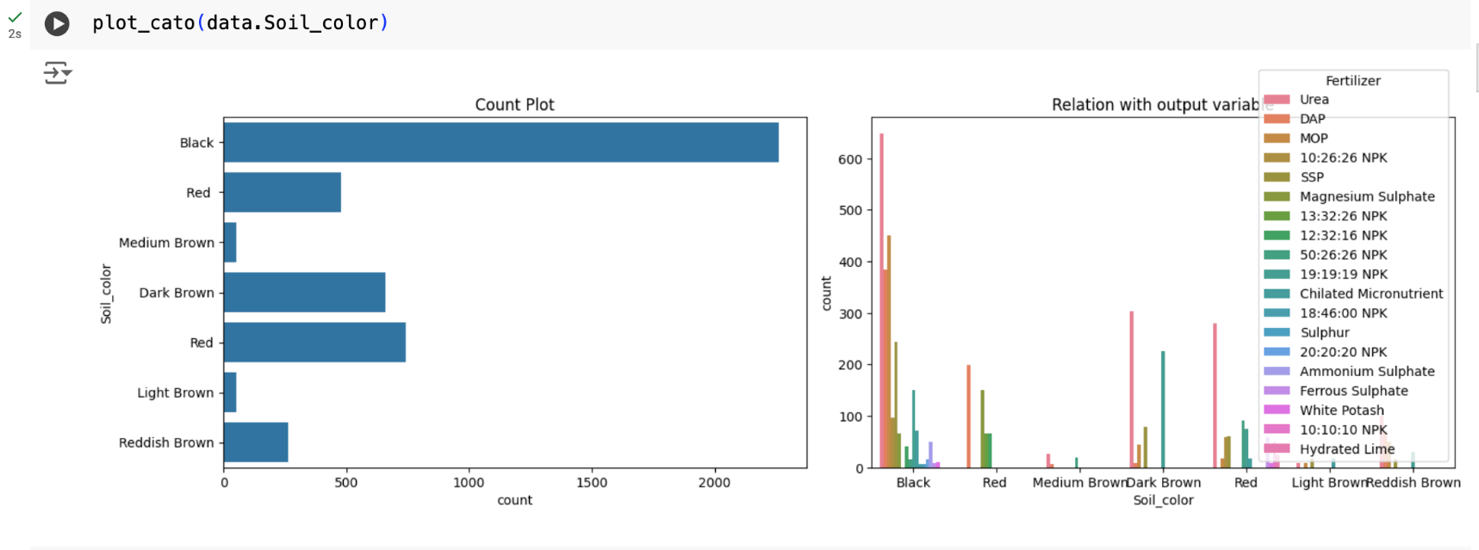
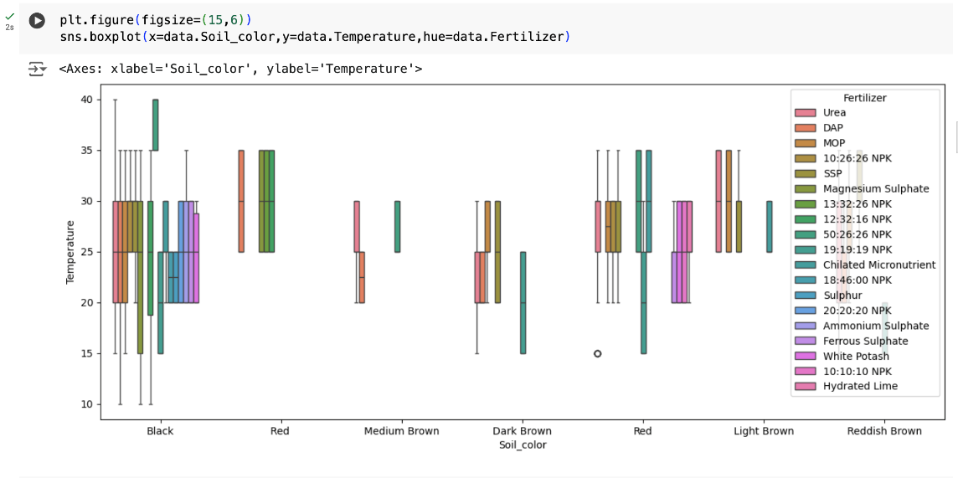
Data distribution

Slide 11
Decision Tree
A Decision Tree is a supervised machine learning algorithm used for both classification and regression tasks
balances interpretability and performance while being relatively lightweight.
Decision Trees can model non-linear relationships between features and the target variable without requiring a linear assumption.
INPUT: sensor data, Rainfall, Crop, Soil
OUTPUT: Fertilizer/Crop

Slide 12
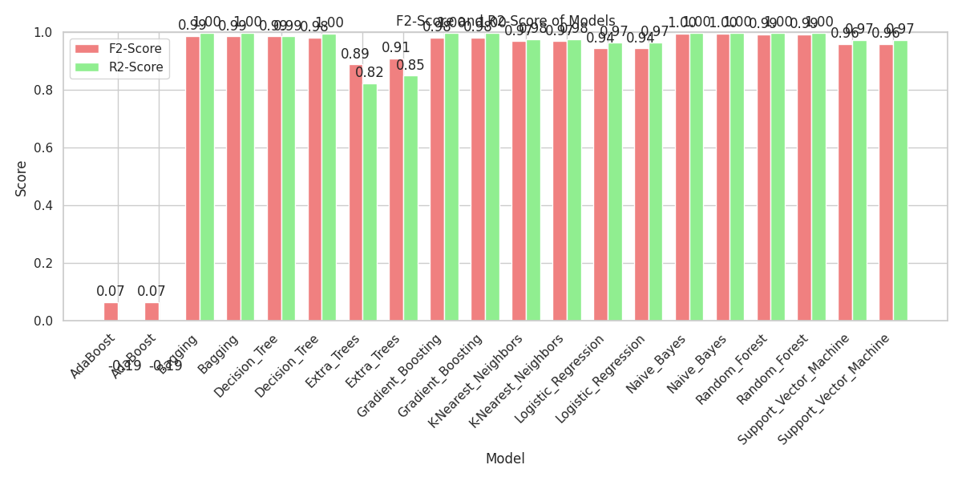
Scores and Accuracy for Crop Recommendation

Slide 13
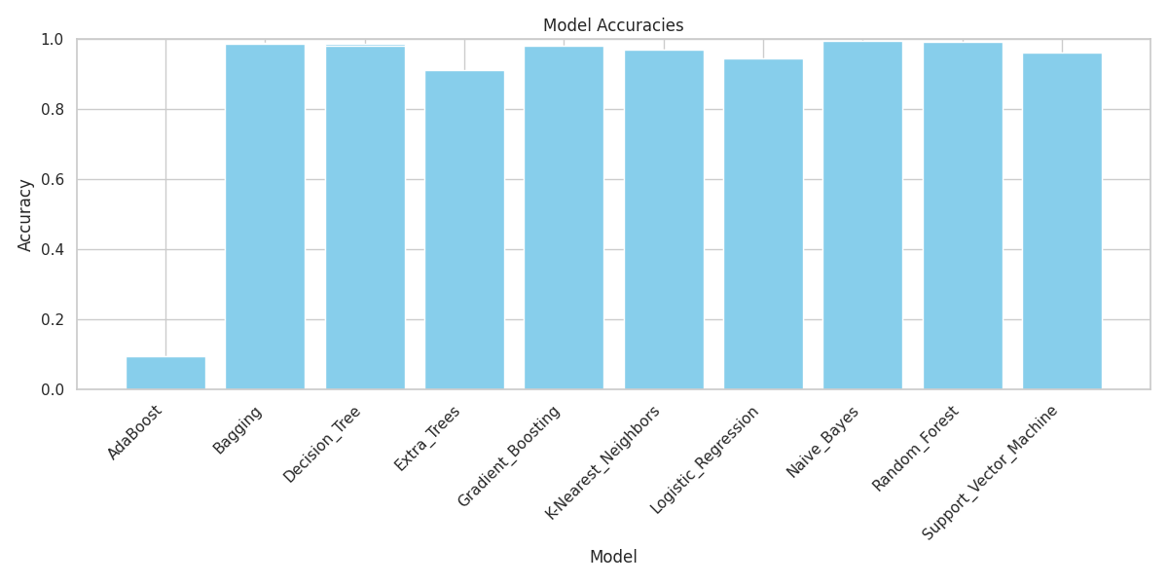
Scores and Accuracy (Crop Recommendation)

Slide 14
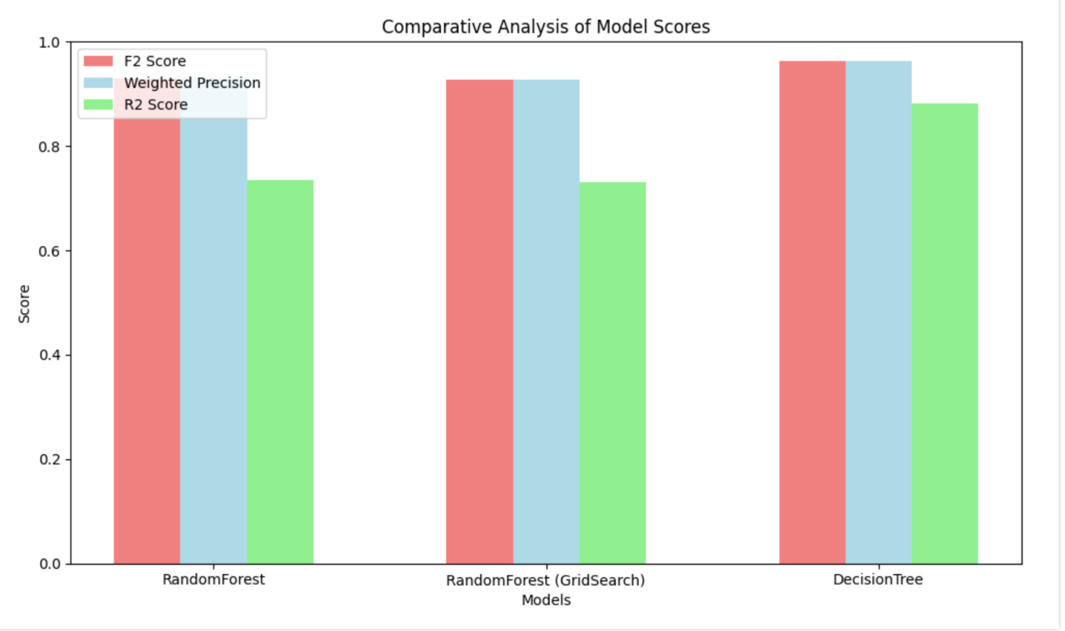
Models and Accuracy

Slide 15
Where We Fall Short
Achieved real time analysis and fertiliser/Crop recommendation with high accuracy
Decay rate of soil nutrients still remained question mark
No publicly available data sets on change in soil nutrients rate w.r.t crop
No research papers found that explicitly analysed decay rate
Does there exists decay rate :
Some research papers stated about nutrients intake of plant
To analyse this kind of information we need to deploy and collect data for training Or Collect data from any ICAR institutes if available
Which needs Time

Slide 16
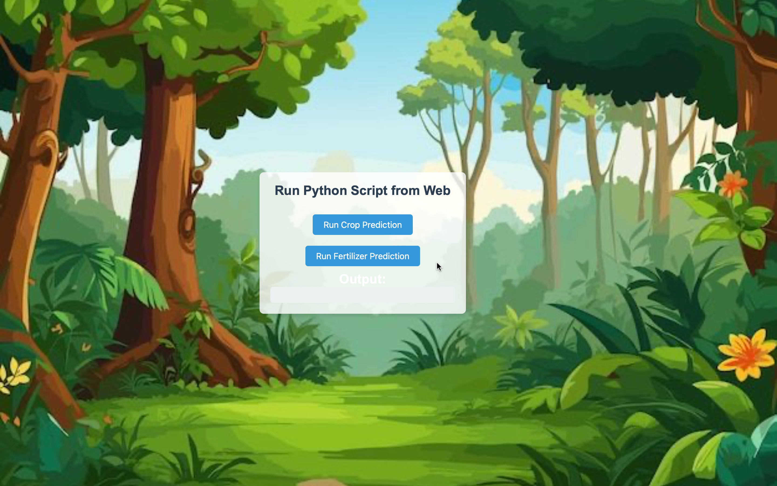
Web Interface for Running the Model

Slide 17
Thank You
Pavan Ponnaganti(34%)
Abhishek Kumar(33%)
Vishal Kumar(33%)

